Slide 1
Paperless is the Future
Speaker：王凯灵, 马洋洋, 吴文昊
2022年3月22日

Slide 2
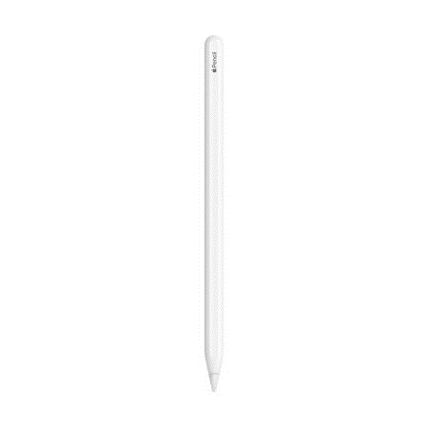
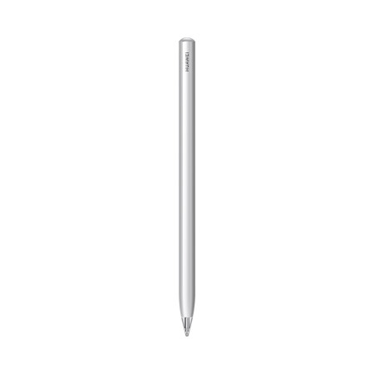
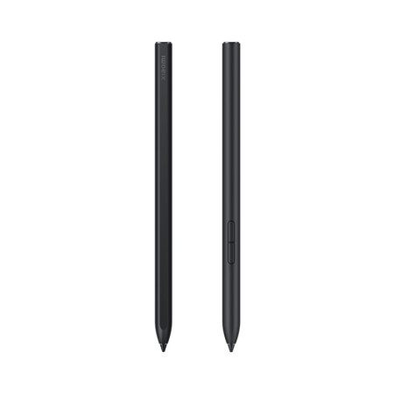

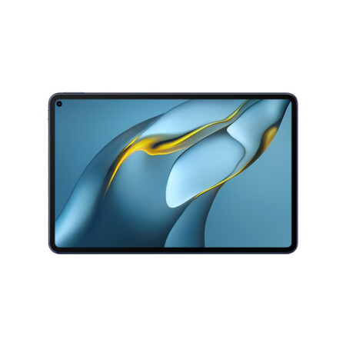

Paperless is the Future

Slide 3
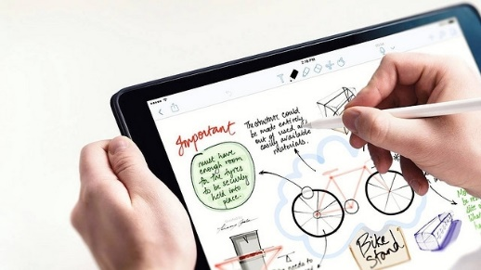
Paperless is the Future
Apple Pencil
Released in 2015
Where paperless study really begins…

Slide 4


Paperless is the Future
Paperless learning
Information
3
Environment
1
Convenience
2

Slide 5
Paperless is the Future
Paperless learning
1
Convenience
2
Environment
3
Information

Slide 6
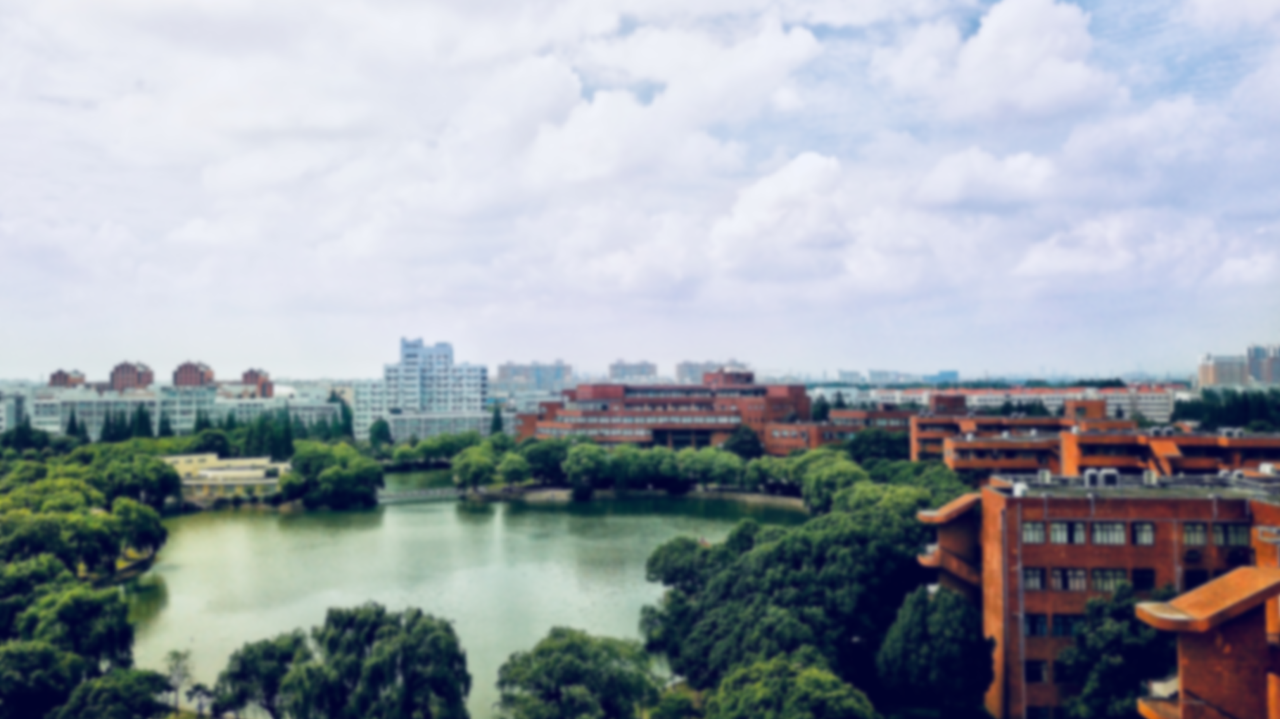

01
Convience

Slide 7
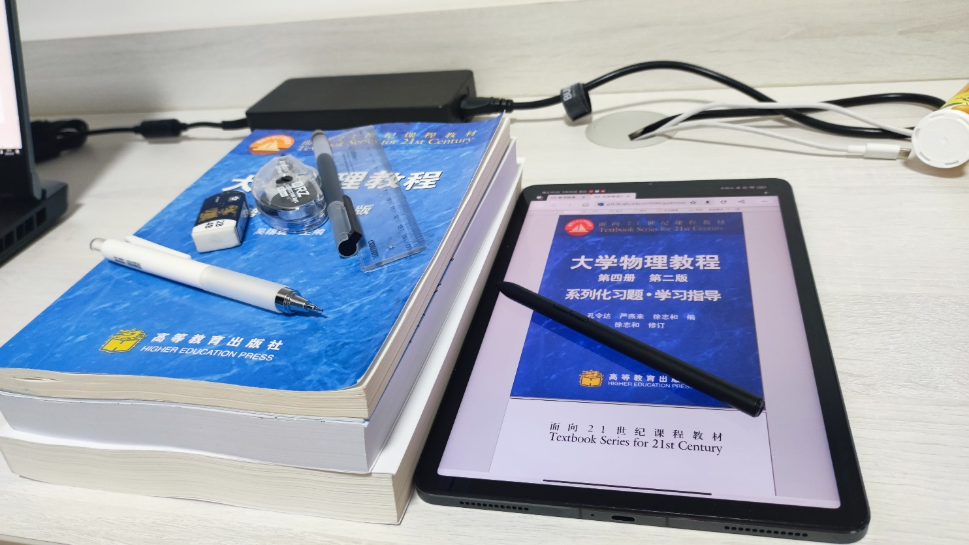
Convenience
textbooks vs pad
Information
3
Environment
1
Convenience
2

Slide 8
Convenience
textbooks vs pad

Slide 9
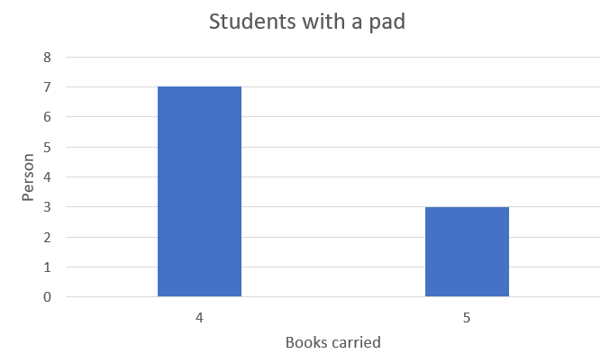
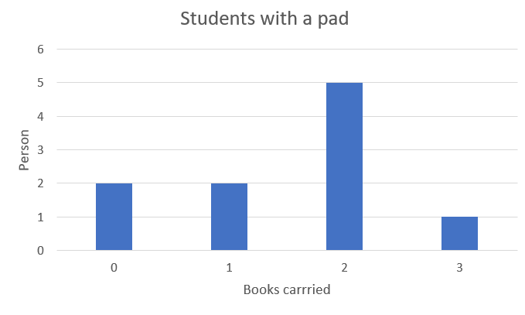
Convenience
Average: 4.3books
Average: 1.6books

Slide 10
02
Environment
protection

Slide 11
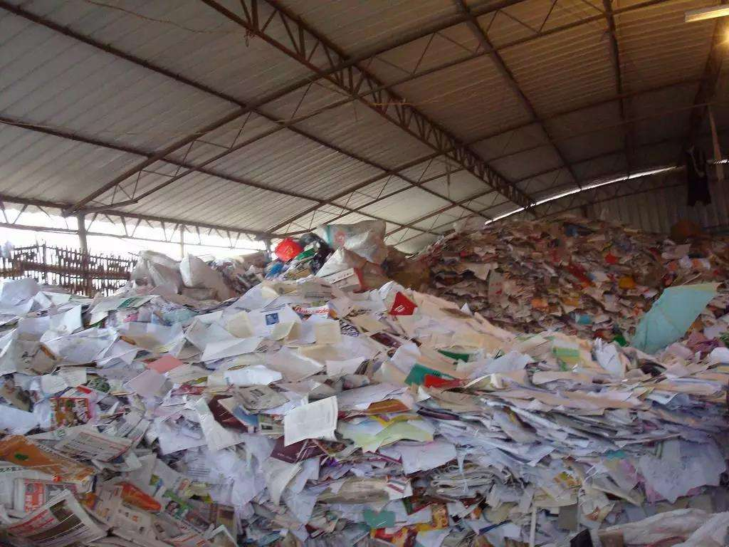
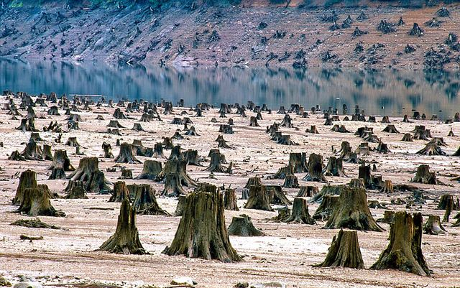
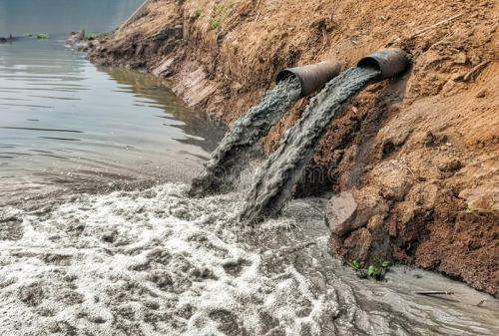
Environment protection

Slide 12
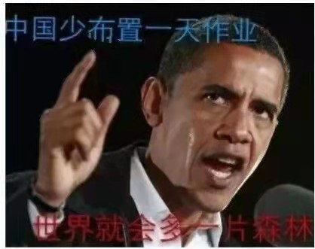
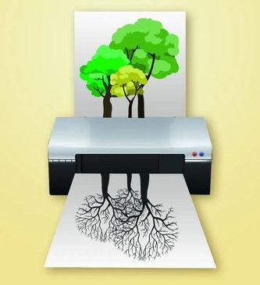
Environment protection
According to the statistics from National Bureau of Statistics(国家统计局), in 2018, China imported more than 20,000,000 tons of pulp. And more than 12,000,000,000 pieces of paper was used for print.

Slide 13
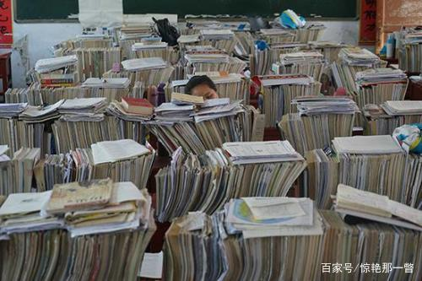

Environment protection

Slide 14
03
Trend of era

Slide 15
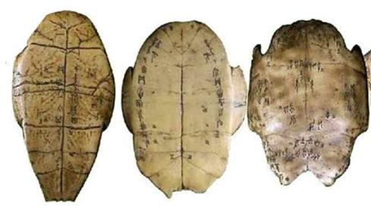
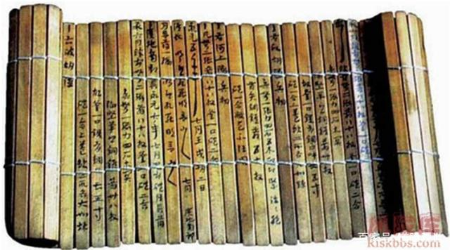
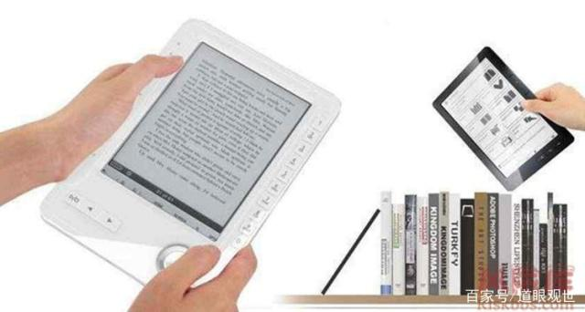
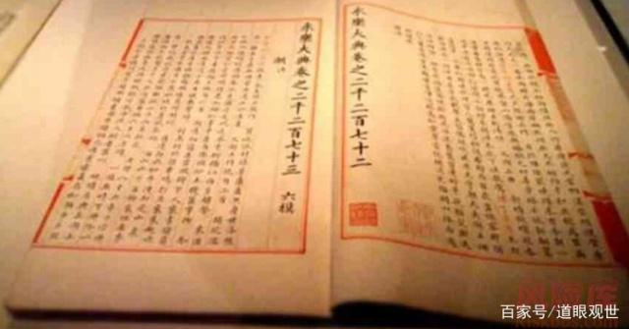
Trend of era
1
2
4
3

Slide 16

Trend of era
In this information era, the Internet allows us to have easy access to various knowledge and learning resources with little limitation.
Also, it requires us to master the ablility to learn with the Internet and without paper.

Slide 17

Conclusion
Paperless learning
Traditional learning

Slide 18
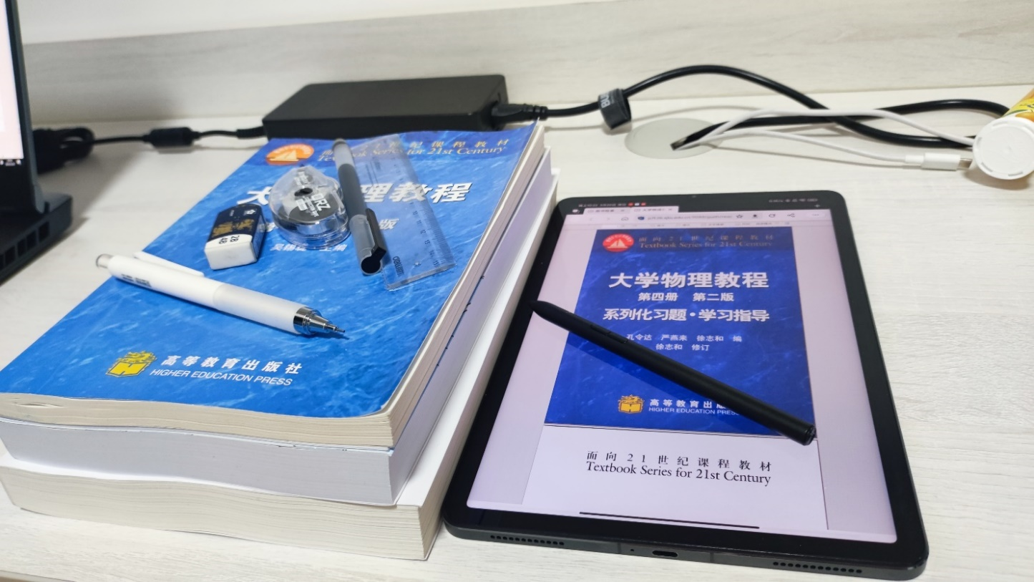


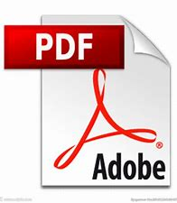
Conclusion
Paper learning
less

Slide 19
感谢聆听

